Slide 1
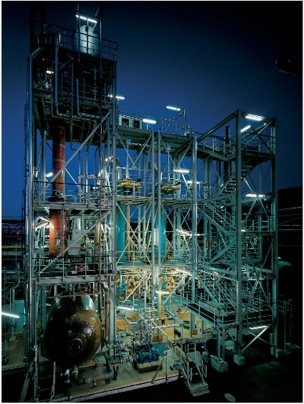
HCl Production
Presented by-
Parth Thakre
Varun Bajpai
Devdutt Sharma
Ruchil Sharma
HCl production plant
Source: http://www.ijesit.com/Volume 2

Slide 2
Introduction
Hydrochloric acid was first discovered around 800 C.E. by the alchemist Jabir ibn Hayyan , by mixing common salt with vitriol (sulfuric acid)
In the Middle Ages, hydrochloric acid was known to European alchemists as spirit of salt or acidum salts. Gaseous HCl was called marine acid air.

Slide 3
Introduction
Hydrogen chloride (HCl) is a monoprotic acid
In aqueous hydrochloric acid, the H⁺ joins a water molecule to form a hydronium ion, H₃O⁺
HCl + H₂O ⇌ H₃O⁺ + Cl⁻
Hydrochloric acid is produced in solutions up to 38 percent HCl (concentrated grade)
Higher concentrations up to just over 40 percent are chemically possible, but the evaporation rate is then so high that storage and handling need extra precautions, such as pressure and low temperature

Slide 4
Introduction
Over 40 processes generate hydrochloric acid as a byproduct and it is consumed in over a 100 processes
Over two third of the global HCL consumption is in the manufacturing of ethylene dichloride (EDC) and the remaining is the manufacturing of inorganic compounds

Slide 5
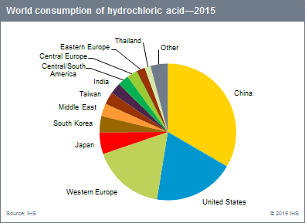

Slide 6
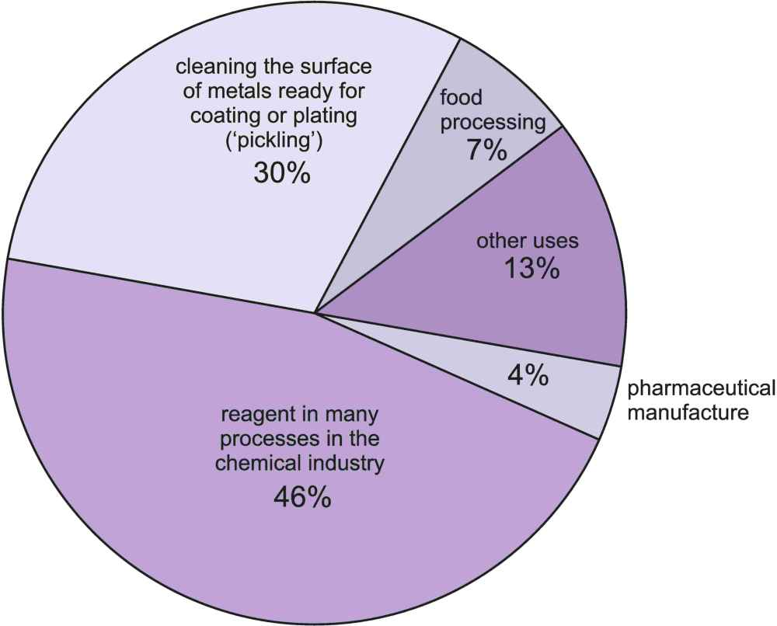
Principle uses of HCl
Source: www.
essestialchemicalindustry.org

Slide 7
Steel Pickling
This is a process whereby rust and scale is removed from steel sheet or coil with the use of a dilute solution of hydrochloric acid. The metal can then be processed. Hydrochloric acid is used in pickling operations for carbon, alloy and stainless steels. Pickling is required for steel products that undergo further processing such as wire production, coating of sheet and strip, and tin mill products. Hydrochloric acid is used primarily for continuous pickling operations in which hot-rolled strip steel is passed through a countercurrent flow of acid solution.

Slide 8
Used in manufacture of organic compounds
HCl is used to manufacture organic compounds such as vinyl chloride and dichloroethane which are used to produce polyvinyl chloride (PVC).

Slide 9
HCl as cleaning agent
One of the strongest commercially available cleaners today is hydrochloric acid. Hydrochloric acid is extremely powerful and is recommended as a cleaner. Industrial strength hydrochloric acid, is commonly used on masonry; however, the acid can be used to clean any product that can withstand its effects

Slide 10
Used to neutralise water in swimming pools
HCl is used to neutralize water in making it safe for bathers. Most often the pH level is high; the best way to lower pH is by slowly pouring hydrochloric acid directly into the deep end of the pool while the pool pump is on and the water is circulating.

Slide 11
Used to regulate pH level
HCl is used to regulate the pH level in a wide range of manufacturing and treatment processes including the production of drinking water, pharmaceuticals, beverages and foods. It is used in the processing of additives for the food industry including fructose, citric acid and hydrolyzed vegetable protein.

Slide 12
To regenerate ion exchangers
High-quality hydrochloric acid is used in the regeneration of ion exchange resins. HCl is very efficient and does not cause precipitations in the resin bed. Cation exchange is widely used to remove ions such as Na⁺ and Ca²⁺from aqueous solutions, producing demineralized water. The acid is used to rinse the cations from the resins. Na⁺ is replaced with H⁺ and Ca²⁺ with 2H⁺.

Slide 13
Used in activating oil wells
HCl is used in a process known as oil-well acidization. This process involves injecting the acid into the cavities of oil wells to dissolve away sections of rock, leaving an open column behind. Ultimately, the method serves to accelerate oil production from the well

Slide 14
Production of inorganic compounds
Numerous products can be produced with hydrochloric acid in normal acid-base reactions, resulting in inorganic compounds. These include water treatment chemicals such as iron(III) chloride and polyaluminium chloride (PAC).
Fe₂O₃ + 6 HCl → 2 FeCl₃ + 3 H₂O
(ferric oxide) (ferric chloride)
Both iron(III) chloride and PAC are used as flocculation and coagulation agents in wastewater treatment, drinking water production, and paper production.

Slide 15
Chemical Weapons
Phosgene (COCl₂) was a common chemical warfare agent used in World War I. The main effect of phosgene results from the dissolution of the gas in the mucous membranes deep in the lung, where it is converted by hydrolysis into carbonic acid and the corrosive hydrochloric acid. The latter disrupts the alveolar-capillary membranes so that the lung becomes filled with fluid (pulmonary edema).
Hydrochloric acid is also partly responsible for the harmful or blistering effects of mustard gas. In the presence of water, such as on the moist surface of the eyes or lungs, mustard gas breaks down to form hydrochloric acid.

Slide 16
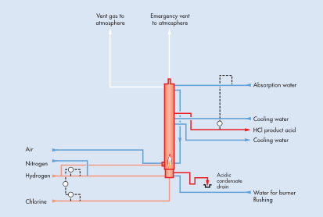
Flowsheet (H2 and Cl2)
http://www.sglgroup.com

Slide 17
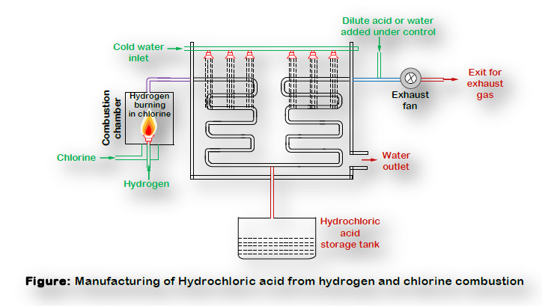
HCL from hydrogen and chlorine combustion
Image Source - NPTEL

Slide 18
Process Description
The burning of hydrogen is started by igniting the burner with an external air-hydrogen torch. (An oxyhydrogen torch is an oxy-gas torch, which burns hydrogen (the fuel) with oxygen (the oxidizer). It is used for cutting and welding, metals, glass, and thermoplastics)
Dry chlorine is passed into the combustion chamber, where hydrogen burns in an atmosphere of chlorine to produce HCl.
The exothermic nature of the direct combination of both gases (H2 and Cl2) is such as to raise the temperature of the reagents, and the reaction products to a point where they are incandescent.
The reaction is carried out at 24000C with greenish flame.
The gases are always kept above dew point to avoid corrosion.

Slide 19
Process Description
The combustion chamber is then cooled externally by water and gas tight lid is fitted at the top of the reactor which suddenly opens to allow the gases to escape in case of emergency.
Hydrochloric acid gas is cooled absorbed in water or dilute HCl solution by passing through cooler and absorber through the connecting pipe.
The strength of acid produced is generally 32-33 %.
Combustion chamber of structural carbon or lined with silica bricks provided with cooling device which may consist even of cold-water circulation in the shell.
Silica is wear resistant
To ensure all the chlorine reacts with hydrogen, excess of 10% hydrogen compare to chlorine is charged from the bottom of combustion chamber.

Slide 20
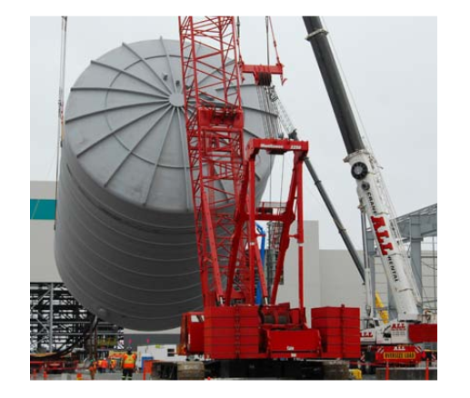
Ultra-Large HCl Tanks
Image Source -T. Johnson, J. Graham and D. Kelley Ashland Performance Materials

Slide 21
Materials for construction for a hydrochloric acid plant?
Most metallic materials are not compatible with hydrochloric acid including aluminium alloys, iron and steel, galvanized steels, and stainless steels.
Ni-Cr-Mo alloys can be used in some applications as long as the concentrations and/or temperatures are not too high.
Tantalum offers good resistance to hydrochloric acid but it is expensive.
Non-metallic materials have better resistance to hydrochloric acid than metallic materials.
Rubber-lined vessels are commonly used for hydrochloric acid storage. Polypropylene, PVC, PTFE, FEP, PFA, ECTFE, PVDF, and FRP can be used as long as long as recommended temperature limits are followed.
Paint/coating systems may be acceptable they are prone to damage and can allow hydrochloric acid to reach the substrate which is often not compatible

Slide 22
Hastelloy
Hastelloy is the registered trademark name of Haynes International, Inc. The trademark is applied as the prefix name of a range of twenty-two different highly corrosion-resistant metal alloys, loosely grouped by the metallurgical industry under the material term “superalloys” or “high-performance alloys”
B-2 is used for HCL
B-3 has better thermal stability

Slide 23
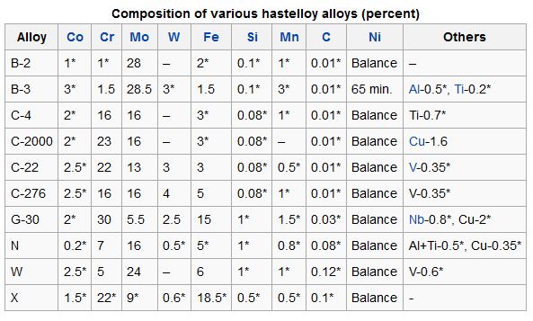
Hastelloy
Image Source-Haynes International, Inc.

Slide 24
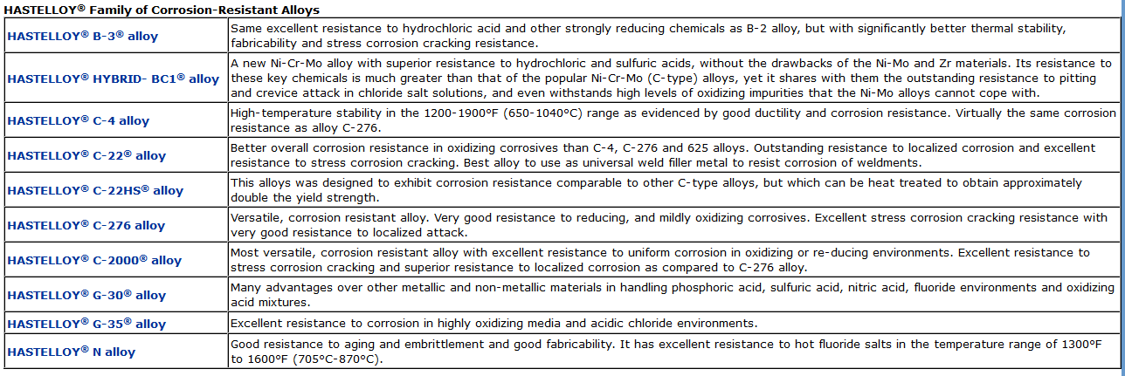
Hastelloy properties
Image Source-Haynes International, Inc.

Slide 25
Material Of Furnace Construction
The construction material of the HCl Furnace is Diabon (an impregnated graphite material high rate of heat transfer)
Combustion chamber and absorber are incorporated in a steel shell which acts as a cooling jacket.
This unit is protected with a diabon bursting disc due to over-pressure (max. 0.3 bar) initiates discharge of the hydrogen chloride vapours at the top of the unit.
The high response accuracy rupture disc absorbs explosions and the steel shell will resist to even more violent explosions, which are practically only possible in case of mal-operations
An emergency cut-off system is provided to avoid damage by overheating or explosion.

Slide 26
Thermodynamics and kinetics
H2 + Cl2 → 2HCl ΔH = - 44kcal
On account of the existence of large energy barrier to the reaction, mixture of molecular H2 and Cl2 is stable at ambient temperatures in absence of suitable wavelengths.
Photons with frequencies which are able to furnish the activation energy can be produced by creating an electrical spark in a mixture of molecular H2 and Cl2
or
First burn mixture of H2 with air and then gradually replacing air with chlorine.
The initiation, propagation and termination of the chain reactions are as follows

Slide 27
Reaction Steps
Initiation
Cl2 + hυ -> 2Cl•
Propagation
Cl• + H2 -> HCl + H+
H• + Cl2 -> HCl + Cl•
Termination
Cl• + Cl• -> Cl2 + heat
H• + H• -> H2 + heat
H• + Cl• -> HCl +heat
A large amount of heat is developed both from chain propagation reactions and from chain termination processes.

Slide 28
Engineering aspect
The combustion chamber should be sufficiently specious for avoiding wall effect.
Walls of reactor in which chain reactions takes place by their varying nature, shape and orientation as to affect the chain carriers is called wall effect.
In the present case wall tends to interrupt the process by promoting the chain breaking reaction (termination reactions).

Slide 29
Cooling the Furnace Product
Product gas temperatures from the reactor (furnace) exceed those allowable for absorption. The method used for absorption varies with the temperature and volume of the gas being processed.
Some cooling is achieved in the pipeline carrying the gas from the generating unit to the cooler or cooler-absorber.
In synthesis plants using impervious graphite or silica coolers, the pipe may be cooled with external water sprays.
Generally, the high-HCl low-volume gases are cooled in tubular equipment, and the low-HCl high-volume gases by heat interchange with concentrated hydrochloric acid in packed towers. For this particular design the cooling is achieved by a tubular exchanger known as the Trombone Cooler. Other names include trickle coolers or cascade coolers.

Slide 30
Trombone cooler
Trombone coolers are S-shaped bends, consisting of a bank of standard pipes one above the other in series and over which water trickles downward, partly evaporating as it travels .
Tubes are made out of impervious ceramic material for cooling corrosive gases at atmospheric pressure, such as HCl and NO2 that may be cooled by exterior water or may be jacketed.
Trombone coolers are also available in cross-flow types and banks of impervious graphite tubes have been used which are submerged in running water. Packed columns may also be used for the low volume gases.

Slide 31
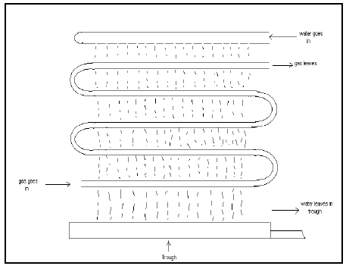
Trombone cooler
IMAGE SOURCE-THE COPPERBELT UNIVERSITY SCHOOL OF TECHNOLOGY CHEMICAL ENGINEERING DEPARTMENT HYDROCHLORIC ACID PLANT DESIGN

Slide 32
Advantages of the Trombone Cooler
Its pipes are made of ceramic material which offers a very good resistance to high temperature corrosive gases.
It does not consist of a lot of components hence it is easier to design than most other types of coolers.
It’s relatively cheaper to design compared to other types of coolers.

Slide 33
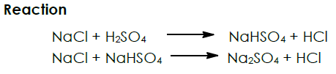
Alternative Process (Process Description)
The reaction between NaCl and sulphuric acid occurs in two endothermic stages.
Salt (NaCl) and sulphuric acid are charged to the furnace. It is desirable to keep one of the components in the reaction mixture in a liquid form in both steps.

Slide 34
Process Description
The first step is carried out at the lower temperature compare to second step. For liquefaction of NaHSO4, which is required to carry out in second step, material is heated up to 400°C.
Sodium sulphate in form of sludge is collected from the bottom of the furnace. The product and unconverted sulphuric acid is sent to further processing in which recovery of sulphuric acid and nitric acid takes place in cooling tower and absorber respectively.

Slide 35
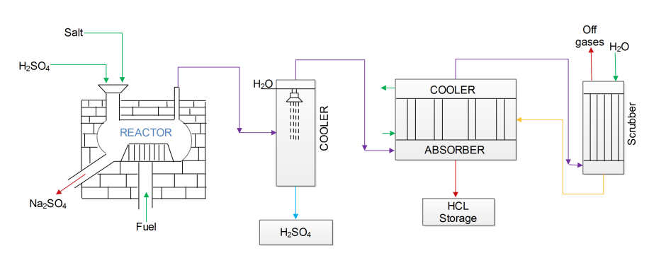
Diagram with process equipment
Source : NPTEL

Slide 36
FLOWSHEET ANIMATION
Source : NPTEL

Slide 37
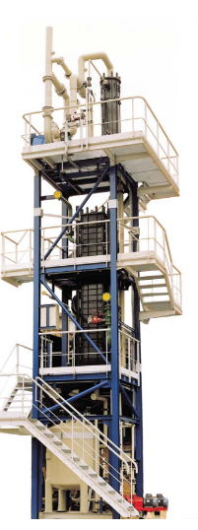
Absorption of HCl Gas
The Absorption of hydrogen chloride in water or dilute hydrochloric acid is a central operation In the production of hydrochloric acid.
The absorption is a highly exothermic process which heats up the gas and the absorption liquid. Therefore, the absorption is often performed in combined equipment – DIABON heat exchanger and DIABON columns.
Source : www.sglgroup.com

Slide 38
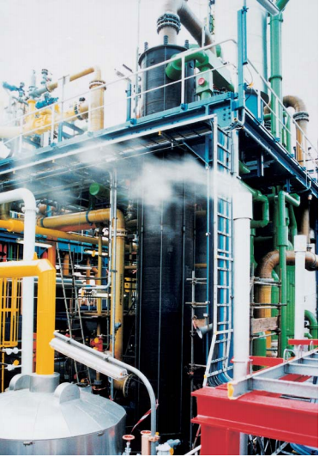
Stripping Process
Hydrochloric acid can be contaminated with undesirable volatile constituents such as chlorine etc. These impurities have low boiling points and can be removed by stripping or rectification in a single step process.
Source : www.sglgroup.com

Slide 39
ENVIRONMENTAL ISSUES,HEALTH ISSUES,FUTURE ASPECTS,ECONOMIC ANALYSIS

Slide 40
ENVIRONMENTAL ISSUES
Due to high mobility of Cl,HCl can readily acidify both soils and surface water. ACID DEPOSITION
Large concentration of HCl in the environment may lead to acid rain
Metal rusting
Ozone Depletion CORROSION
Corrosion of cast iron and steel increases with increase in HCl concentration
PHYTOTOXICITY
Gaseous HCl having concentration between 5 -20 ppm could kill the plants within 2 days
Lesions in fir,beech and oak leaves

Slide 41
HEALTH ISSUES
TOXICITY
HCl primarily irritates and attacks the membranes of the eyes and upper respiratory tract.
Prolonged exposure to low conc. of HCl causes discolouration and erosion of teeth.
Bleeding of nose and gums,tenderness of facial skin CHRONIC EFFECTS
Gastritis,dry mouth
Chronic Bronchitis,burning sensation
Dermatitis
People not accustomed to HCL mists showed a 9% decrease in the pulmonary peak flow rate when exposed for 1 hour to HCl mists
EPA has not classified HCl with respect to potential carcinogenicity

Slide 42
EFFECTS OF HCL INHALATION ON HUMANS
CONCENTRATION-PPM | SYMPTOM | COMMENTS
5 | Long-term sustainable limits | No Organic Damage
10-50 | Production of tears,coughing,sneezing and a runny nose | Irritation
50-100 | Difficulty in breathing,chest pain | Working conditions are difficult
100-1000 | Difficulty in opening the eyes | Intolerable
1000-1300 | Impossible to breathe,unconsciousness | Dangerous
1300-2000 | Lethal Dose | Lethal
NATIONAL AIR POLLUTION ADMINISTRATIVE,MARYLAND,US

Slide 43
SAFE HANDLING OF HCL
HCl shipping containers must be tightly sealed and should be corrosion resistant.Words such as “Deleterious Substance” should be written on the container.Name,grade,net weight should also be mentioned on the container.
TRANSPORTATION
In case of consolidated transport,alkalis and metals should be placed away from HCl container
The driver must be certain to close all the manholes or valves so that the liquid does not leak
Chains,pulleys or makeshift lifts should not be used.Acid bottles shouldn’t be held by their cap. STORAGE
Acid containers should be placed as acid can corrode the floor and building indoor
Storage container should be acid resistant and floor should be coated with asphalt to avoid corrosion
Electrical facilities should be airtight and corrosion resistant.Plastic coated wires should be used
Avoid direct sunlight or close proximity to heat source
Regular check on acid quantity should be kept in order to prevent overflow.
A ventilation hole can be installed in the tank and connected to hazard prevention facility

Slide 44
FIRE PRECAUTIONS
Although HCl is non-combustible,it corrodes metals to generate hydrogen.Isolate any flames during the operation of the pipelines and the tank
If the tank or pipes are welded using flame,ensure that HCl has been discharged
TREATMENT OF EMPTY CONTAINERS AND WASTE
Sufficiently clean the empty containers using water to remove any remaining HCl after emptying the tank.
When HCL is being disposed of,neutralize it by adding milk or soda ash,and then dilute it with large quantities of water
ACCIDENT PREVENTION MEASURES
Operating Rules
Voluntary Inspection
Survey by qualified Persons
Prevention of erroneous operations
Education and training

Slide 45
TECHNOLOGY VISION 2020
HCl industry is expected to grow by 15.7% CAGR year on year
HCL demand will continue to grow,primarily due to its use as a lead chemical in oil and gas industry
HCL manufacturing industry leaders will focus primarily on :
Environmentally sound processes
More energy efficient processes
Safe handling of HCl
Discover and expand the usage of HCl in other industries

Slide 46

CENTRAL POLLUTION CONTROL BOARD
West Bengal Control Board has listed HCl under special RED category chemicals.
The permissible amount of HCl is 90MT/D as per the Maharashtra Pollution Control Board.
The emission standard as per Central Pollution Control Board is 50mg/Nm3 for HCl.
www.cb.gov.in

Slide 47
ECONOMIC EVALUATION
YEAR | QUANTITY(TONS.)
2006 | 1843
2007 | 1678
2008 | 1578
2009 | 1388
2010 | 1243
2011 | 2105
2016 | 2397
2023(Projected) | 4670

Slide 48
ANNUAL RAW MATERIAL CONSUMPTION
S.No. | Raw Materials | Unit of Measurement | Capacity | Total(Cost)
1). | Sulphuric Acid(98%) | Ton | 4,000 | 32000
2). | Salt(Nacl-96%) | Ton | 5,000 | 7500
3). | Packing materials for HCl(50kg plastic drum) | Pcs. | 560 | 84
4). | Packing materials sodium sulphate(50kg PP bag) | Pcs. | 1,200 | 12
5). | Total |  |  | $39,596

Slide 49
ANNUAL UTILITIES REQUIREMENT AND COST
S.No. | Description | Unit Of Measurement | Quantity | Cost(USD)
1). | Electricity | kWh | 912,000 | 528,960
2). | Furnaces Oil | Lt. | 240,000 | 3521,200
3). | Water | m3 | 80,000 | 800,000
Total |  |  |  | 4,850,160

Slide 50
References
http://nptel.ac.in (NPTEL)
The Copperbelt University School Of Technology Chemical Engineering Department Hydrochloric Acid Plant Design
http://chloralkalitechnology.blogspot.in/p/hcl-synthesis-plant.html
www.worldofchemicals.com
http://www.haynesintl.com/cralloys.htm
http://www.thomasnet.com/southern-texas/hastelloy-monel-nickel-bolts-6560304-1.html
www.essestialchemicalindustry.org
http://www.sglgroup.com
http://www.madehow.com/Volume-6/Silicon.html

Slide 51
THANK YOU

